Slide 1
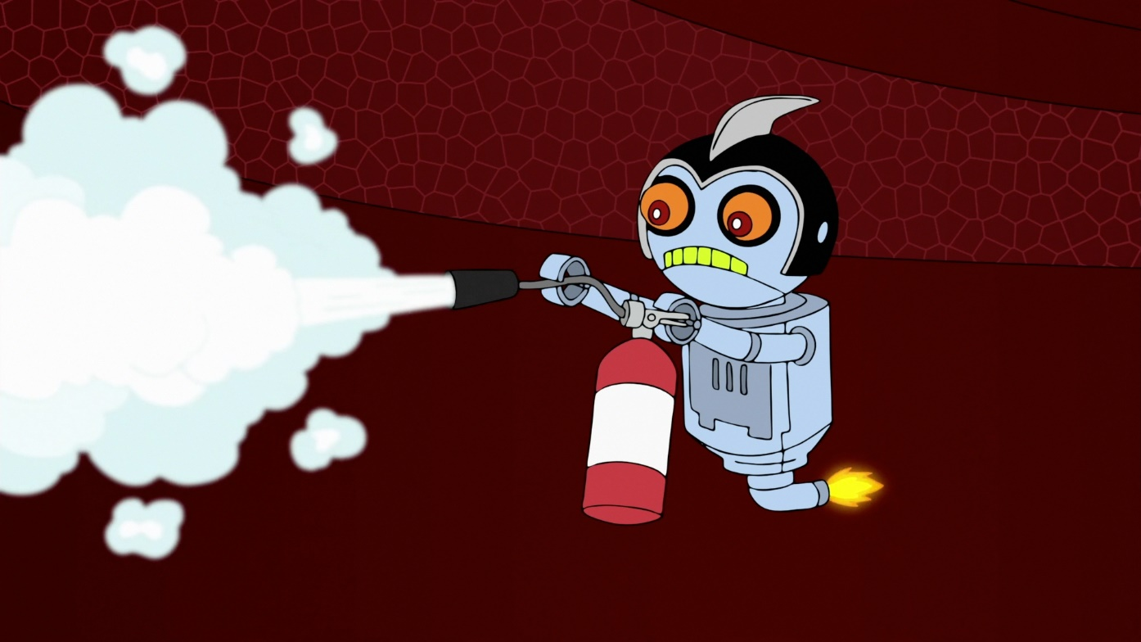
FIRE Fighting and rescue bot
CSE 291 Final Project
-Vijay Ch.
-Harsha
-Nikhil Srivastava

Slide 2
What can the bot do?
Placed in an environment consisting of fire and critical victims, the bot will rescue the victims and put out the fire
We depict the fire using a light source such as a light bulb or candle and the victims using bright objects
The bot will navigate around the area trying to match the objects with images of the objects provided to it before the run and move towards them
It will sound a rescue alarm once its in close proximity with an object and will move on to the next one
Once it finds the fire source, it will move towards it and extinguish it with a mounted USB powered fan
Perform a victory dance on successful firefighting

Slide 3
Fundamental tasks
Perception nodes and sensor integration: Vijay
Decision nodes and processing: Harsha
Action nodes and master slave communication: Nikhil

Slide 4
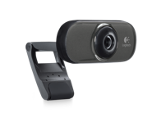
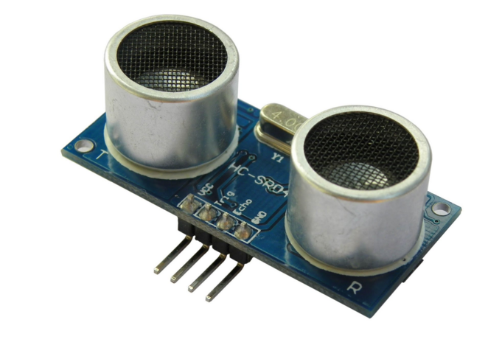
1: PERCEPTION
Utilizing two onboard sensors:
USB Camera: For visual perception
HC-04 Ultrasonic sensor: Non-contact range measurement

Slide 5
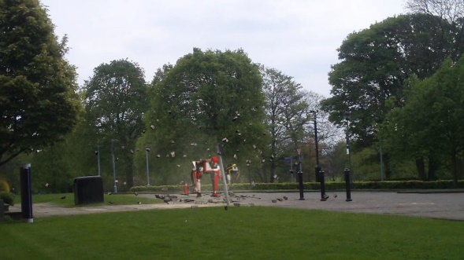
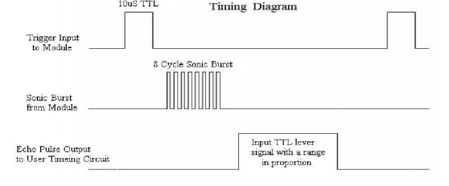
About the sensors
USB Camera:
Ultra sonic sensor:
Working range of 400cm to 2cm
Distance = (output high level time)*(340m/s)/2

